Slide 1
Assigning Bit Material

Slide 2
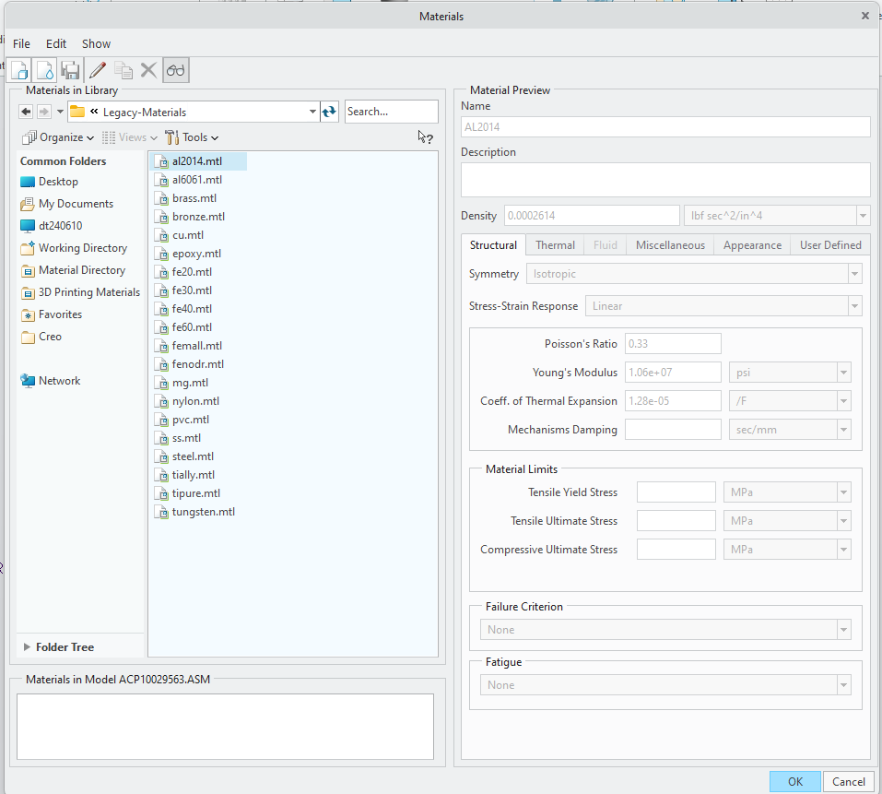
Adding Material to Model
File > Prepare > Model Properties
On the Material line (top line), select "change"
Double-click on Legacy-Materials folder to expand
Double-click "steel.mtl" to add to model
Select Ok
Other materials could be added if desired
4

Slide 3
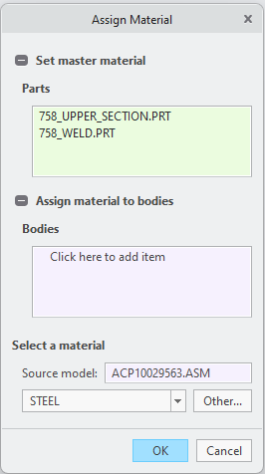
Assigning Material to Bit
On the Mass Properties line, click "change"
Select "Assign Material"
Select material under "Select a material"
Select Ok
3

Slide 4
Last Slide

